Slide 1



The Robustness of Mental Accounting Across 21 Countries
Open access paper download:
Priolo, G., Stablum, F., Vacondio, M., D’Ambrogio, S., Caserotti, M., Conte, B., ... & Rubaltelli, E. (in press). The Robustness of Mental Accounting Across 21 Countries. Journal of Consumer Research.
https://doi.org/10.1093/jcr/ucag022
Pre-registrations, Materials, Data, and Syntax: https://osf.io/u3j9b/?view_only=315ffe29f0b742b99943a943315a53e2
David J. Hardisty | ACR Annual Conference | 26th Sep 2026 | Chicago

Slide 2

Authors
Giulia Priolo, Federica Stablum, Martina Vacondio, Simone D’Ambrogio, Marta Caserotti, Beatrice Conte, Prisca De Roni, Hilda du Plooy, Vivian D Grillo, Libera Y Mastromatteo, Elisa Tedaldi, Filippo Toscano, Jesús Aguilar-Armijo, Parisa Ahmadi Ghomroudi, Lucian Alexa, Mathias H Andersen, Per A Andersson, Karine Aoun Barakat, Carolina Barros, Ruggero Basanisi, Tara Beilner, Sergiu Burlacu, Thai Cao, Alessandra Carella, Arianna Chiappi, Zafer Çiftçi, Claudia Civai, Alana Daly, Valdonė Darškuvienė, Marta De Pedis, Earle J du Plooy, Mohammed El-Mir, Christian T Elbæk, Sondos Elkot, Valeria Fanghella, Eman Farahat, Amy G Fehl, Ama P Fenny, Paul A G Forbes, Gemma Garbi, André Gonçalves, Sevias Guvuriro, Ali Hajian, Steve Heinke, Austin Howard, Sudharsana Jagatheesh Jayanand, Peiran Jiao, Gabriela Jiga-Boy, Alejandra Jordano De Castro, Tobias Kalenscher, Austėja Kažemekaitytė, Afreen Khalid, Kiana Kothe, Philip Krüger, Ngân Lê Thị Kiều, Gintarė Leckė, Yanina Ledovaya, Mengyu Lim, Luca M Lüpken, Huong Mai Thi Xuan, Laura Mangold, Alfarisi Maulana, Maya Maze, Hajdi Moche, Zahra Moradi, Adel Moumin, Valeria Nava, Michelle J Y Neoh, Leonardo Nicolao, Hamza O. K. El Hallaoui, Sebastian Olschewski, Adobea Y Owusu, Ahmet F Ozates, Sofia Pelica, Sonja Perkovic, Ananda W M Puteri, Hagai Rabinovitch, Guilherme A Ramos, Nicole Robitaille, Caroline Roux, Benjamin Scheibehenne, Martin Schoemann, Mohammad Seidisarouei, Sanjay Singh, Mustafa Z Söyük, Liza Steiner, Amira Tarek, Berto Usman, Hannah van Alebeek, Mohammad H Vazirian, Evgeniya Vedernikova, Janet L Wijaya, Xinxin Zhu, Jichuan Zong, Leaf Van Boven, Stephan Dickert, Lorella Lotto, David J Hardisty, Justin Pomerance, Beatriz Pereira, Kai Ruggeri, Enrico Rubaltelli
David J. Hardisty | ACR Annual Conference | 26th Sep 2026 | Chicago

Slide 3
Theoretical background
Mental accounting is «a set of cognitive operations used by individuals and households to organize, evaluate, and keep track of financial activities» (Thaler, 1999)
Ground-breaking response to the «homo economicus» perspective
Key factor in explaining consumer behaviors (see reviews from Silva et al., 2023; Skwara, 2023)
Inspired many real-life marketing and policy applications worldwide
David J. Hardisty | ACR Annual Conference | 26th Sep 2026 | Chicago

Slide 4

Mental Accounting Scenarios Tested
Scenario: Jacket (Kahneman & Tversky, 1982; Tversky & Kahneman, 1981)
Effect: Framing of outcomes
Conditions: 2, You are about to purchase a jacket that costs $450/$50 and blue tooth speaker costs $50/$450. The salesperson informs you that the speaker is on sale for $30/$430 in another store, 20 min away. Would you make the trip?
Scenario: Play (Kahneman & Tversky, 1982; Tversky & Kahneman, 1981)
Effect: Sunk costs and mental accounts
Conditions: 2, You are on your way a music event, when you discover: You lost a ticket you paid $140 for, do you buy another ticket? / You lost $140 in cash, do you buy a $40 ticket?
David J. Hardisty | ACR Annual Conference | 26th Sep 2026 | Chicago

Slide 5
Mental Accounting Scenarios Tested
Scenario: MrAB (Thaler, 1985)
Effect: Combined vs separate outcomes
Conditions: 4, e.g., MrA wins $300 in one lottery and $150 in another. MrB wins $450 in one lottery. Who is happier?
Scenario: Game (Thaler, 1985)
Effect: Transaction utility
Conditions: 3, You have an extra ticket to a sold-out sports game. The price marked on the ticket is $15 but you got it for free/paid for it/paid $30 when buying from someone. WTA to sell the extra ticket to a friend/stranger; what if the face value is now $30?
Scenario: Drink (Thaler, 1985)
Effect: Transaction utility
Conditions: 2, WTP for a drink a friend will buy for you in a fancy hotel/run-down store
David J. Hardisty | ACR Annual Conference | 26th Sep 2026 | Chicago

Slide 6
Mental Accounting Scenarios Tested
Scenario: Gym (Shafir & Thaler, 2006)
Effect: Local vs global representations
Conditions: 2, You paid a non-refundable per-session entry to the gym for $15/your gym membership costs you $700 a year (roughly $15 per visit). You just changed when you get a call and have to leave without training.
Do you: feel like you wasted $15; you wasted nothing; You feel you wasted something but can not quantify.
Scenario: Plane (Shafir & Thaler, 2006)
Effect: Historical accounting of purchases and bonuses
Conditions: 2, Your friend and you are on the same flight. Your friend purchased a business class upgrade coupon for $50 that came with a second one for free. They offer you the one they got for free/purchased.
Do you: pay $50 to your friend/you consider it a gift/you pay a lower amount than the full amount.
David J. Hardisty | ACR Annual Conference | 26th Sep 2026 | Chicago

Slide 7
Why do we need a replication and our Research Questions
Replication crisis (Krishna, 2021; Munafò et al., 2017; Wood, 2024)
Sample issues: the original studies were run on small, WEIRD samples
Societal changes: the original studies were run mostly in the ‘80
RQ1: Is mental accounting reliable and robust across time and cultures?
RQ2: Are there moderating factors of mental accounting across countries?
David J. Hardisty | ACR Annual Conference | 26th Sep 2026 | Chicago

Slide 8

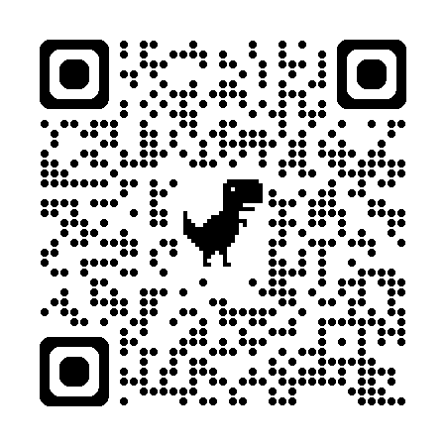
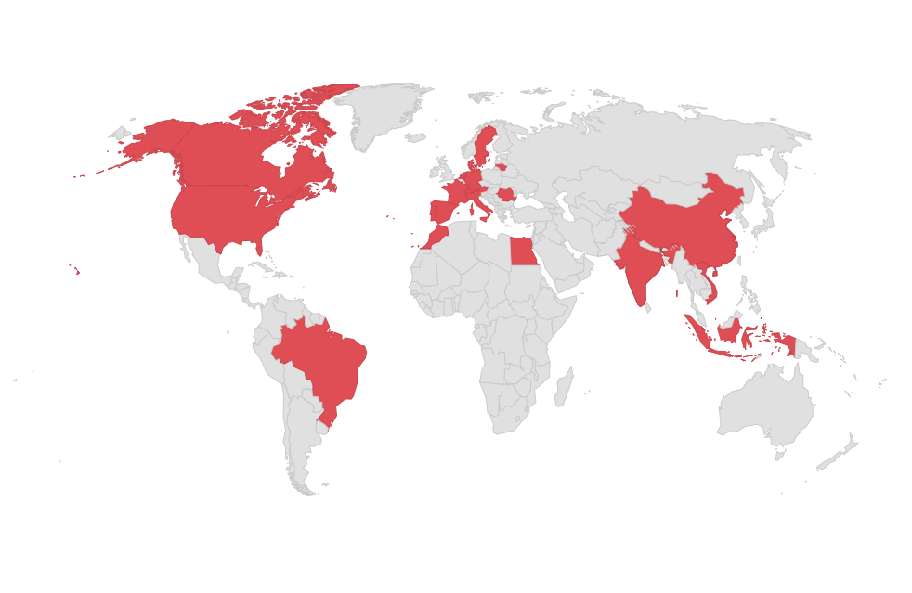
OSF package:
Method
5,589 participants (57.1% female; M_{age}= 30 years)
21 countries (min. 250 participants per country based on power analysis)
General population, no compensation
Online data collection
Social media and snowball sampling
7 foundational scenarios
Within-subject design
Nested block randomization
Financial values adapted to local currency
and current prices
Full survey translated into local language
David J. Hardisty | ACR Annual Conference | 26th Sep 2026 | Chicago

Slide 9
Materials: Moderators
Individual level
Socio-demographic (i.e., age, gender, education, income)
Financial Literacy (Lusardi & Mitchell, 2014; scores from 0 to 4)
Country level
GDP per capita (i.e., total economic output of a country/population at midyear; World Bank 2024)
David J. Hardisty | ACR Annual Conference | 26th Sep 2026 | Chicago

Slide 10
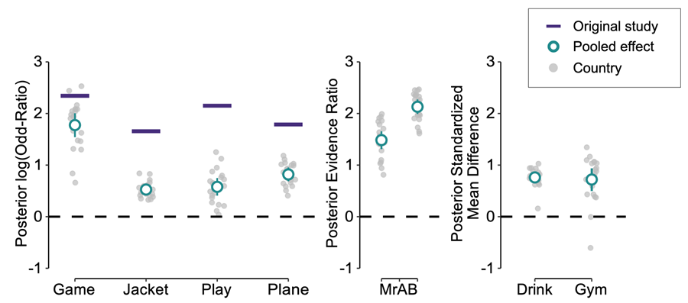
Results RQ1: MA is robust and pervasive
Unpooled hierarchical bayesian meta-analysis
Pooled hierarchical bayesian meta-analysis
90.5% overall replication
100% overall replication
Scenario | Replication Rate
MrAB | 100%
Game | 100%
Drink | 95%
Jacket | 81%
Play | 71%
Gym | 90%
Plane | 95%
Smaller effect sizes than original studies
David J. Hardisty | ACR Annual Conference | 26th Sep 2026 | Chicago

Slide 11
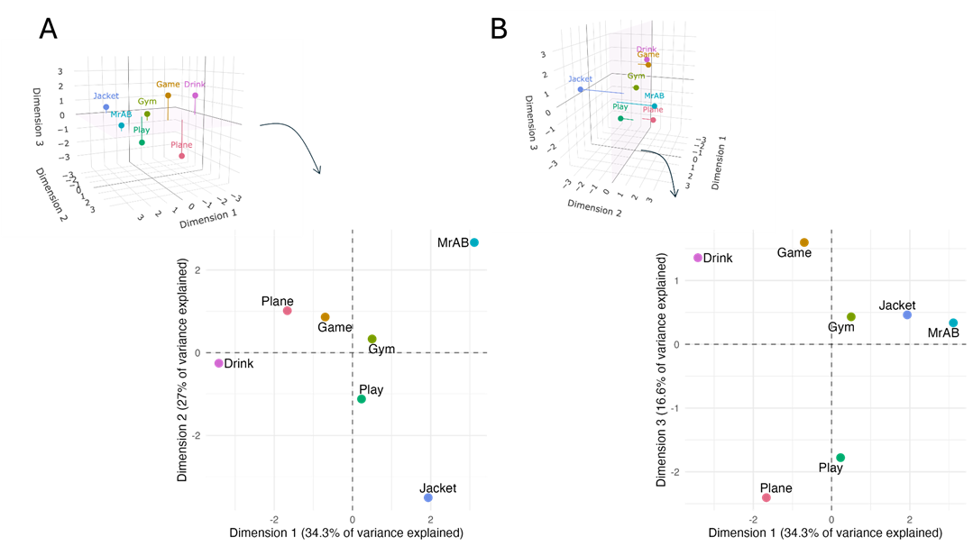
Exploratory Analysis: A three-dimensional structure of MA
Multidimensional scaling (MDS) analysis
Dimension 1/Context: individual vs. interactive
Dimension 2/Perspective: deciding for self/other
Dimension 3/Pricing roles:
setting vs evaluating prices
David J. Hardisty | ACR Annual Conference | 26th Sep 2026 | Chicago

Slide 12
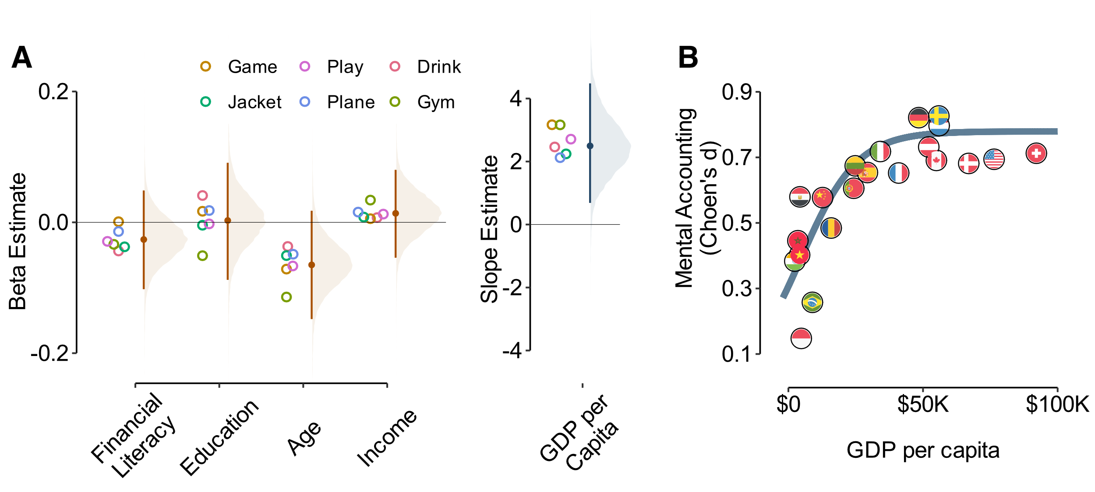
Results RQ2: Higher GDP per capita is associated with stronger MA
David J. Hardisty | ACR Annual Conference | 26th Sep 2026 | Chicago

Slide 13
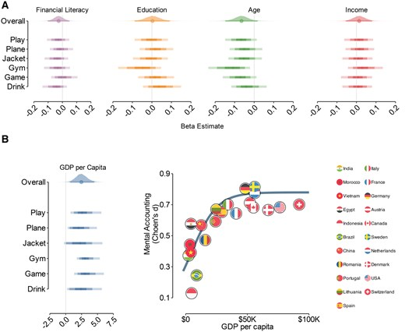

Slide 14
Take home message
Mental accounting is a reliable and robust phenomenon across countries and time.
Using MDS we discovered a three-dimensional structure of mental accounting.
Individual differences do not account for variations in mental accounting, but higher GPD per capita is robustly associated with stronger mental accounting effects.
David J. Hardisty | ACR Annual Conference | 26th Sep 2026 | Chicago

Slide 15
Thank you!
Contacts:
gip.msc@cbs.dk
jdmlab.dpss@unipd.it
david.hardisty@sauder.ubc.ca
David J. Hardisty | ACR Annual Conference | 26th Sep 2026 | Chicago

